Slide 1


TITLE - HOTEL ROOM BOOKING SYSTEM
INSTITUTE OF AERONAUTICAL ENGINEERING
Dundigal,Hyderabad-500 043, TELANGANA, INDIA.
CSE(DATA-SCIENCE)
JAVA FULL STACK DEVELOPMENT
COURSE CODE – ACSD30
Paluvai Sai Karthik – 23951A67C8
Sandhiri Sai Abhinav – 23951A67C2

Slide 2
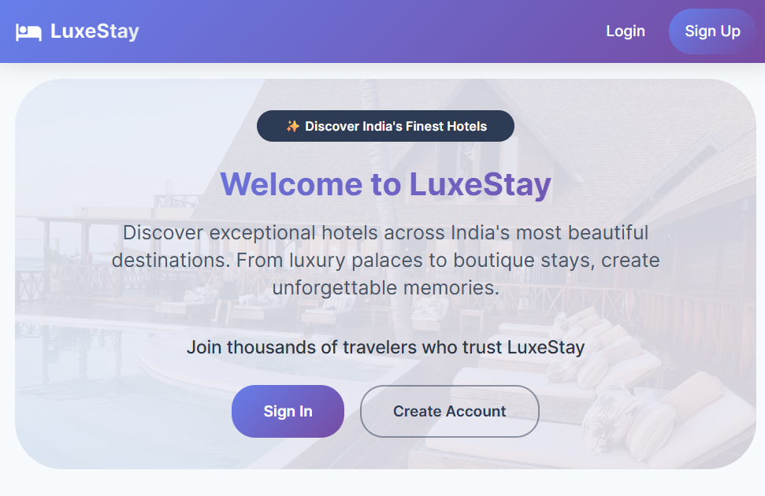
Introduction
The AI-Powered Hotel Booking System is a full-stack web application designed to simplify hotel search, booking, and management.
It leverages AI technology to enhance user experience through intelligent recommendations and chatbot support.
Built with Spring Boot (backend) and React (frontend), it ensures scalability, speed, and security.
The system supports real-time updates for availability and booking confirmations.

Slide 3
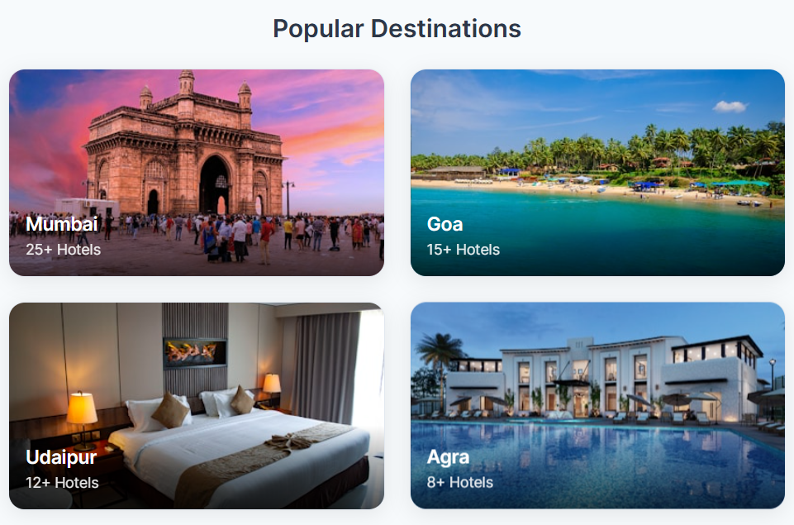
Objectives
Deliver a user-friendly booking interface with advanced search options.
Empower hotel administrators with centralized management tools.
Integrate AI-based assistance for instant customer help and feedback.
Ensure real-time synchronization of room availability and prices.
Implement robust authentication, data protection, and role-based access.

Slide 4
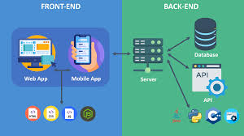
System Architecture
Frontend (React) ↔ REST API ↔ Backend (Spring Boot) ↔ Database (MySQL/PostgreSQL) ↓ Google Gemini AI API ↓ WebSocket for Real-Time Updates
Layers Explanation:
Frontend: Handles user interface and client-side logic.
Backend: Manages business logic and API services.
Database: Stores user, hotel, and booking data.
AI Layer: Provides chatbot and smart recommendations.

Slide 5
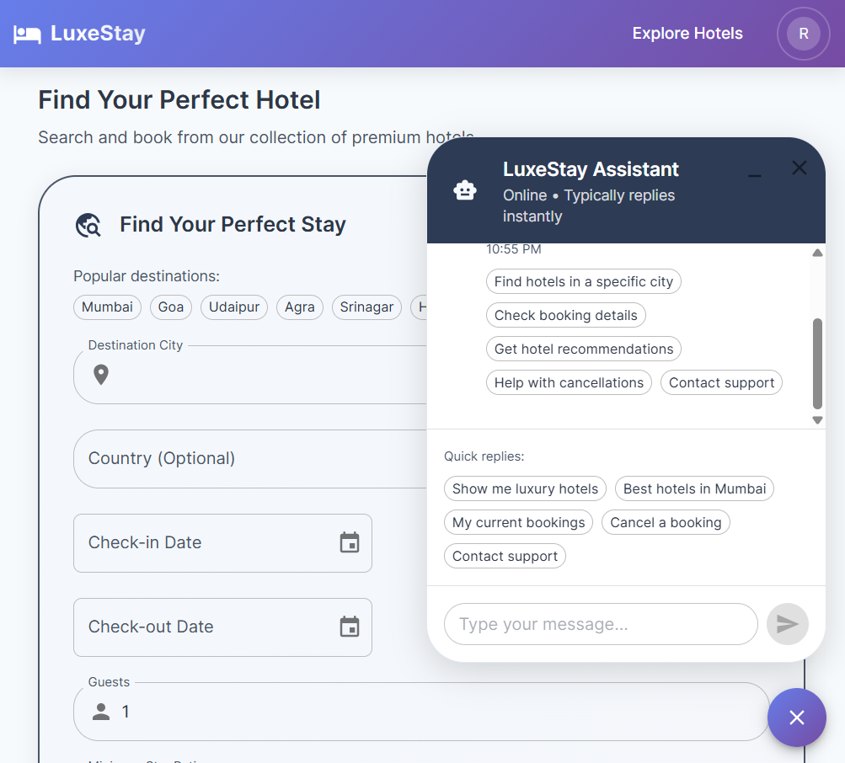
User Features
User Registration & Login: Secure JWT authentication.
Hotel Discovery: Filter hotels by location, price, rating, and amenities.
Instant Booking: View real-time room availability and book instantly.
Booking History: Access past and upcoming reservations anytime.
Profile Management: Update personal details and preferences.
AI Chatbot Support: 24/7 assistant that answers queries and guides users.

Slide 6
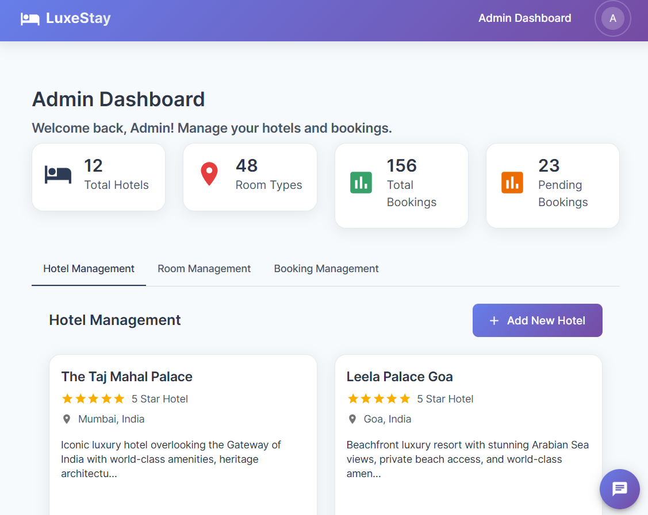
Admin Features
Hotel Management: Add, edit, and delete hotel listings with images and details.
Room Management: Configure room categories, pricing, and capacity.
Booking Oversight: Monitor all ongoing and completed reservations.
User Control: Manage customer accounts and permissions.
Dashboard Analytics: Visual insights into bookings, occupancy, and revenue trends.
Real-Time Sync: Immediate updates reflected across the system for all users.

Slide 7
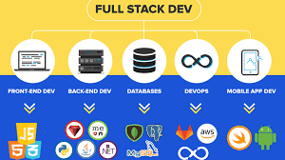
Technology Stack
Frontend: React 18, Redux Toolkit, React Router, Axios, CSS3
Backend: Spring Boot 3.x, Spring Data JPA, Spring Security + JWT
Database: MySQL (main) / H2 (development testing)
AI Integration: Google Gemini API (Chatbot & NLP)
Real-Time Communication: WebSocket
Build Tool: Maven

Slide 8
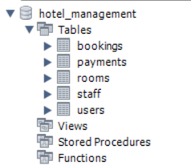
Security & Database Design
JWT Tokens for authentication
Role-Based Access Control for Admin & Customer
BCrypt Password Encryption for safe credentials
Input Validation & SQL Injection Prevention
CORS Policy for controlled frontend-backend communication

Slide 9
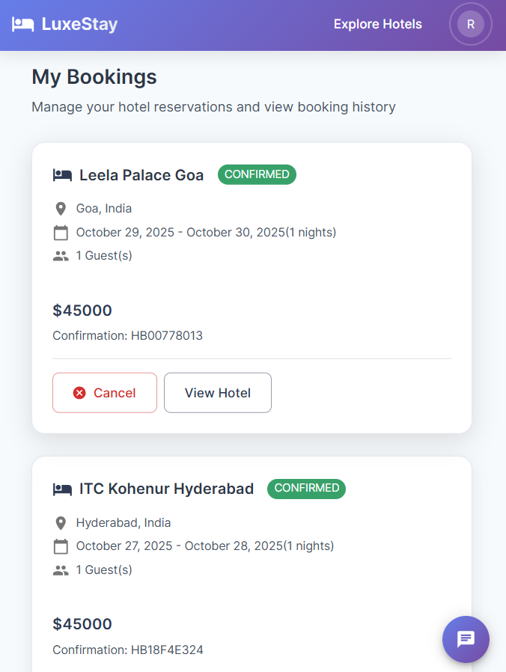
Project Highlights & Future Scope
Project Highlights:
Full-Stack Integration (React + Spring Boot)
Real-Time Functionality with WebSocket
AI Chatbot powered by Google Gemini
Enterprise Security using JWT and BCrypt
Responsive, modern UI/UX design
Future Enhancements:
🌐 Online Deployment on AWS or Render
💳 Payment Gateway Integration (Stripe/PayPal)
📱 Mobile App Development (Android/iOS)
🌍 Multi-language Support
🎁 Loyalty Program & Smart Recommendations

Slide 10
Conclusion
The AI-Powered Hotel Booking System offers a smart, secure, and efficient booking experience.
Combines React, Spring Boot, and AI integration for modern, real-time functionality.
Ensures scalability, data security, and user convenience.
Currently in the development phase with core features tested locally.
Lays the foundation for a future-ready, intelligent hotel management platform.

Slide 11
Thank You

